Slide 1
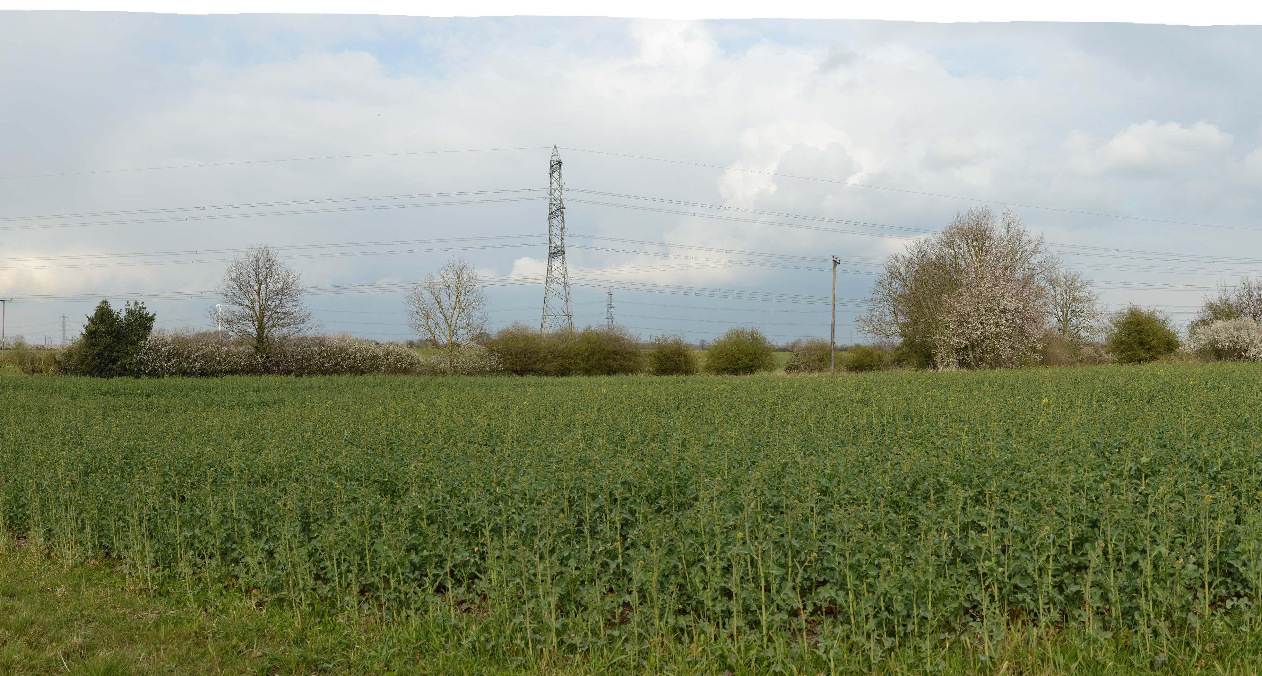
Viewpoint 1: Public Right of Way (PRoW) West of Creyke Beck (Baseline)
Notes:
Viewpoint 1: Public Right of Way South of Burn Park Farm

Slide 2
Viewpoint 1: PRoW West of Creyke Beck with AC Infrastructure
Notes:
Viewpoint 1: PRoW South of Burn Park Farm with AC Infrastructure

Slide 3
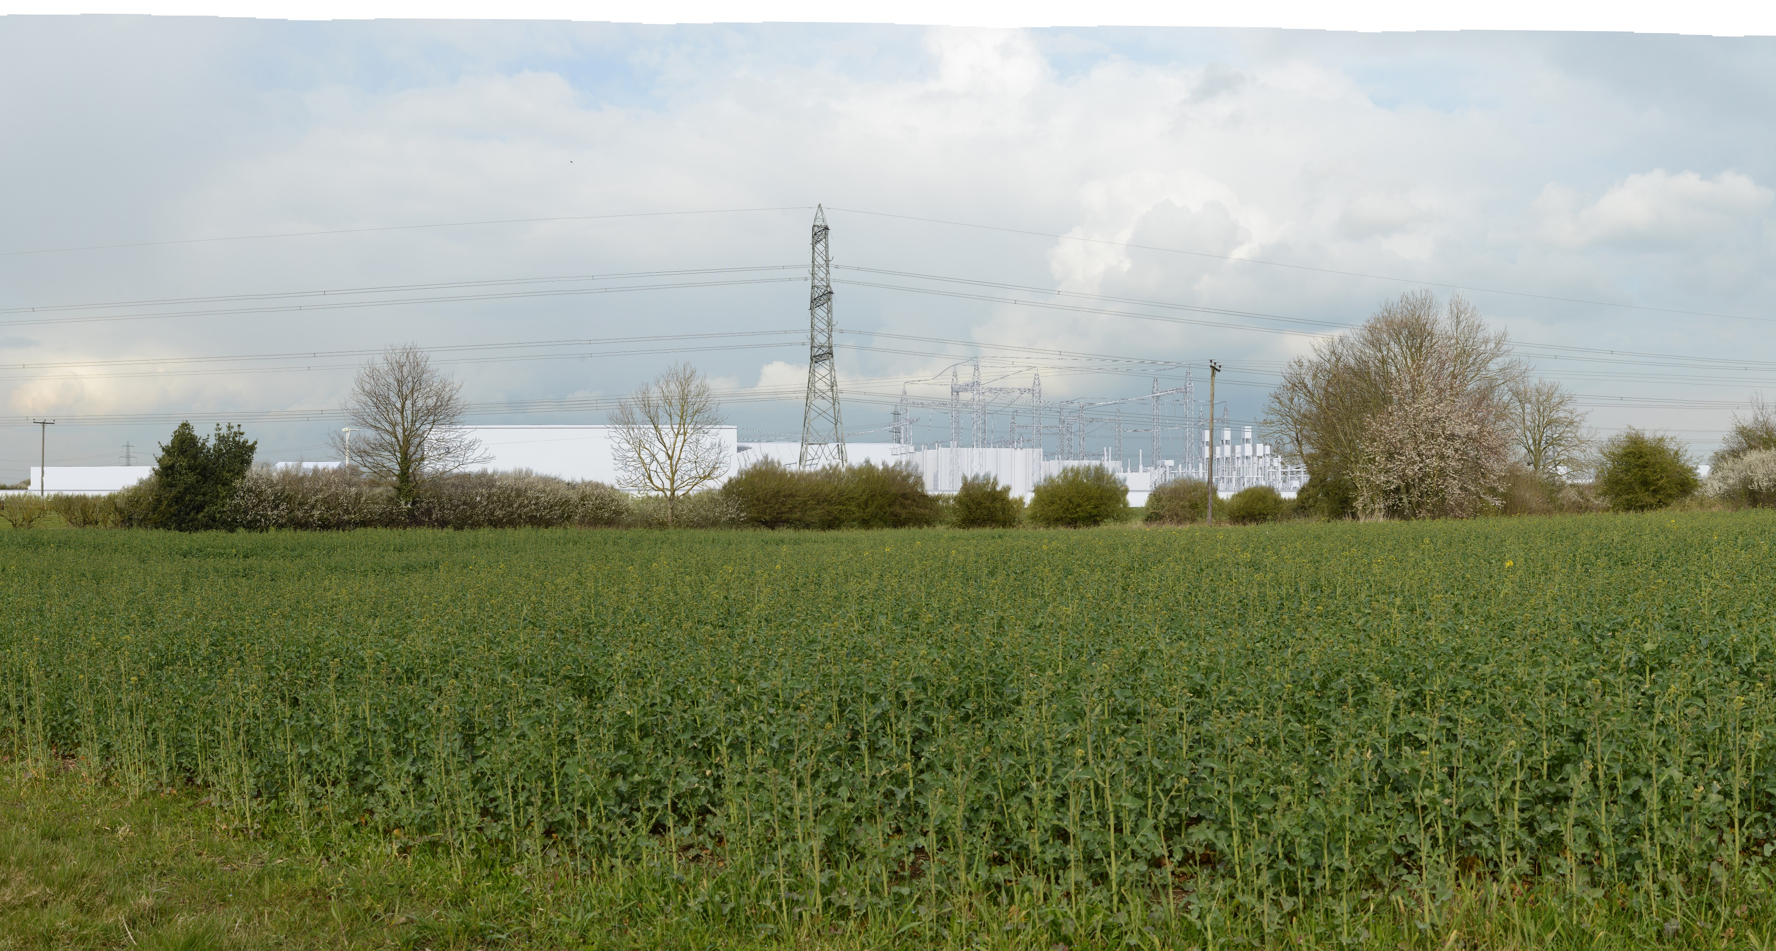
Viewpoint 1: PRoW West of Creyke Beck with DC Infrastructure
Notes:
Viewpoint 1: PRoW South of Burn Park Farm with DC Infrastructure

Slide 4
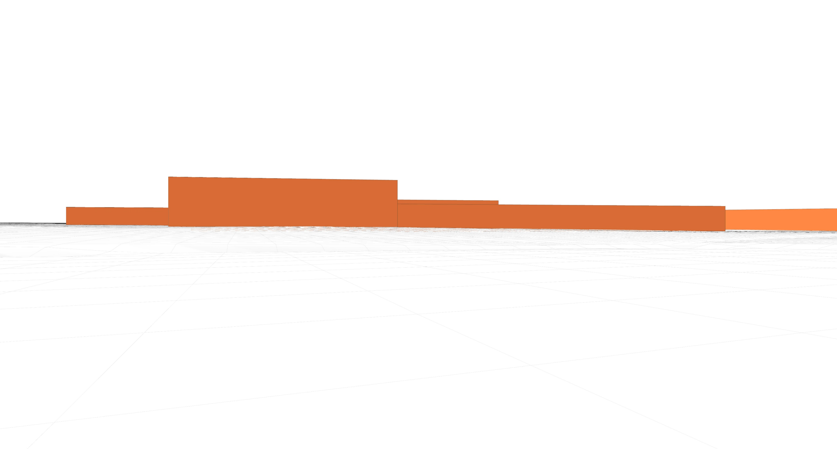
Viewpoint 1: PRoW West of Creyke Beck Wireframe Model View

Slide 5
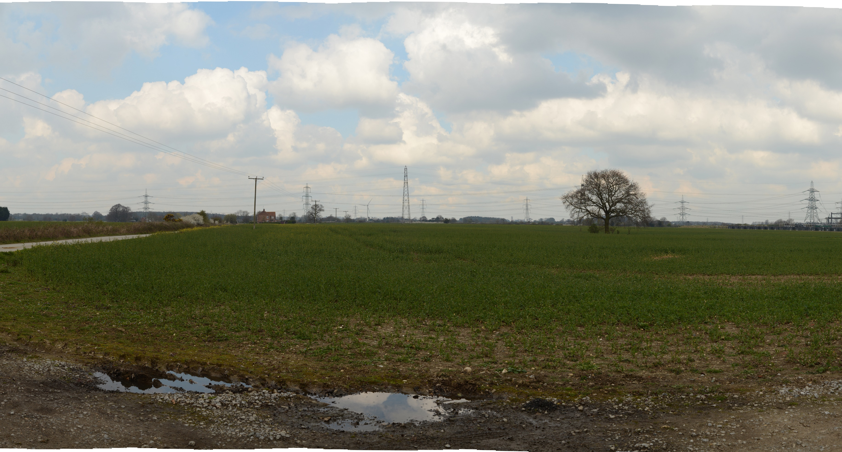
Viewpoint 2: Park Lane Cottingham (Baseline)
Notes:
Viewpoint 2: Park Lane Cottingham

Slide 6
Viewpoint 2: Park Lane Cottingham with AC Infrastructure

Slide 7
Viewpoint 2: Park Lane Cottingham with DC Infrastructure

Slide 8
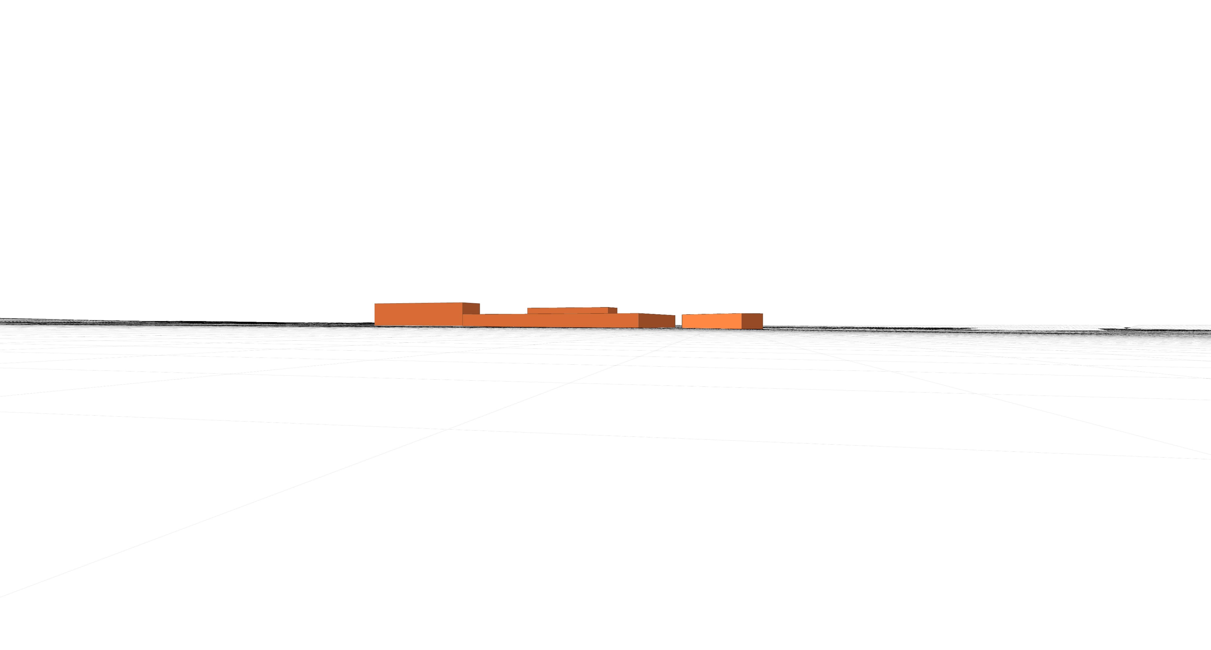
Viewpoint 2: Park Lane Cottingham Wireframe Model View

Slide 9
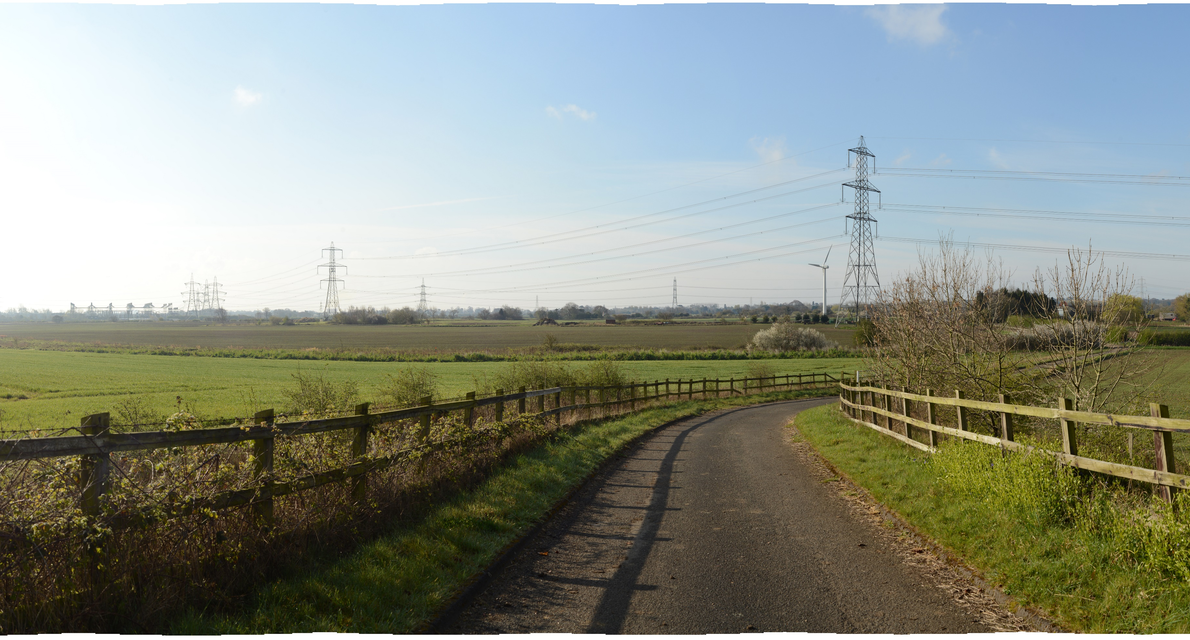
Viewpoint 3: Footbridge over A1079 (Baseline)
Notes:
Viewpoint 3: Footbridge over A1079

Slide 10
Viewpoint 3: Footbridge over A1079 with AC Infrastructure

Slide 11
Viewpoint 3: Footbridge over A1079 with DC Infrastructure

Slide 12
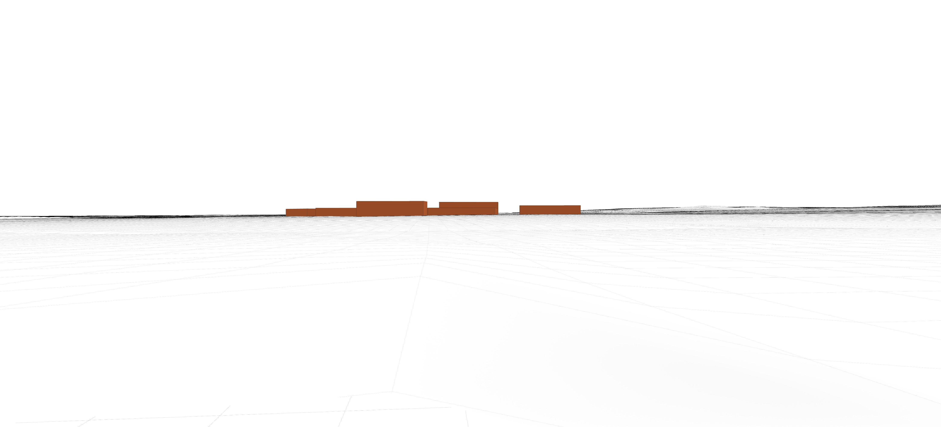
Viewpoint 3: Footbridge over A1079 Wireframe Model View

Slide 13
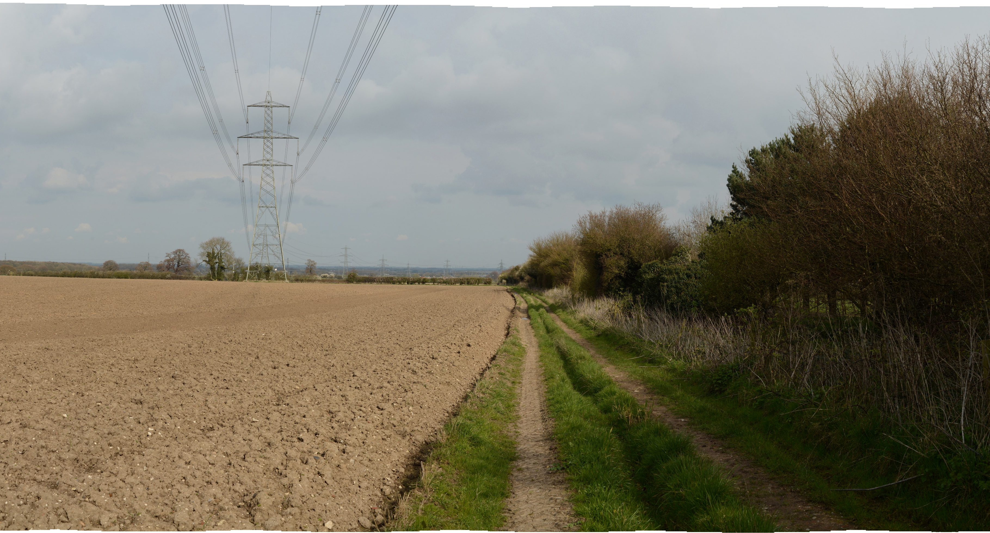
Viewpoint 4: PRoW east of A164
Notes:
Viewpoint 4: PRoW east of A164

Slide 14
Viewpoint 4: PRoW east of A164 with AC Infrastructure

Slide 15
Viewpoint 4: PRoW east of A164 with DC Infrastructure

Slide 16
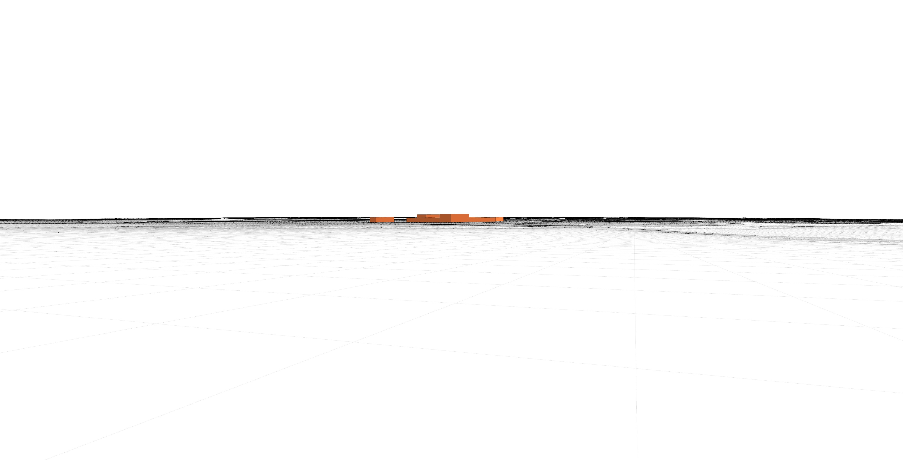
Viewpoint 4: PRoW east of A164 Wireframe Model View

Slide 17
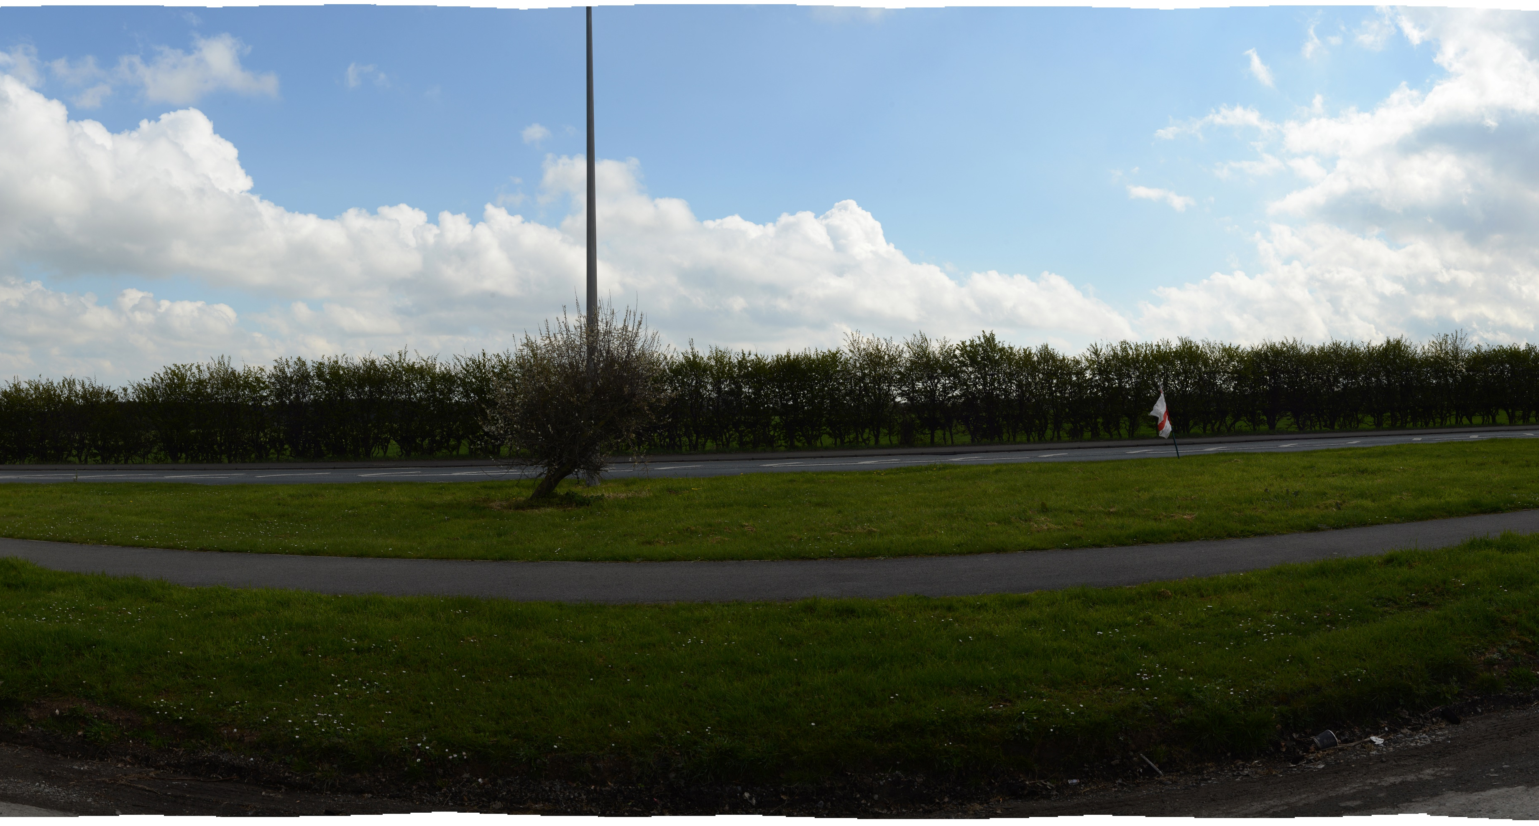
Viewpoint 5: A164 layby near Bentley
Notes:
Viewpoint 5: A164 layby near Bentley

Slide 18
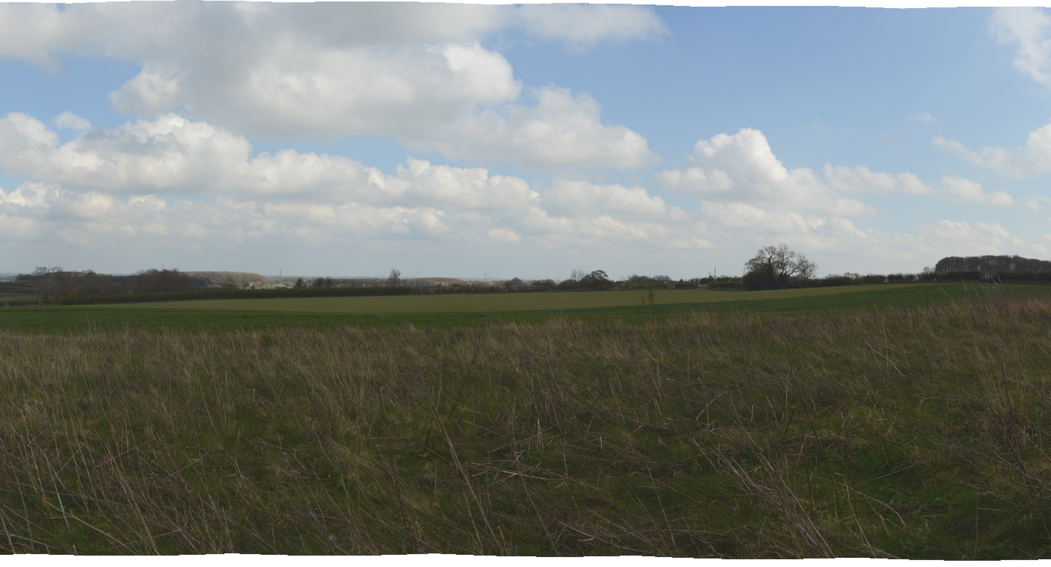
Viewpoint 6: Fishpond Wood Risby Hall
Notes:
Viewpoint 6: Fishpond Wood Risby Hall

Slide 19
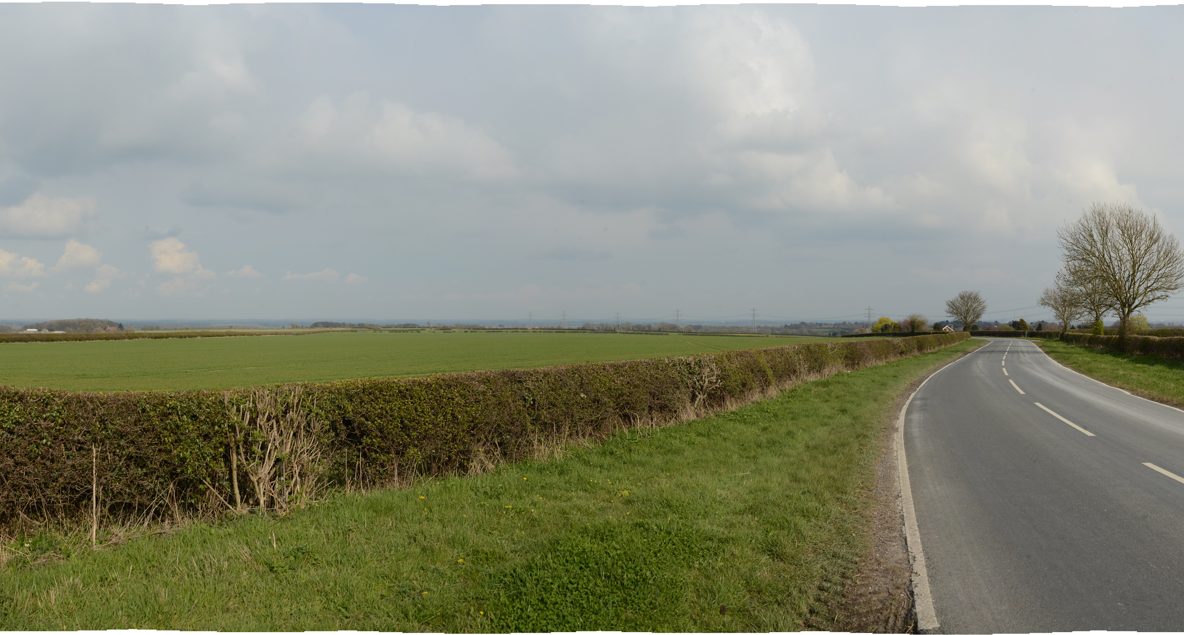
Viewpoint 7: Little Weighton Road
Notes:
Viewpoint 7: Little Weighton Road

Slide 20
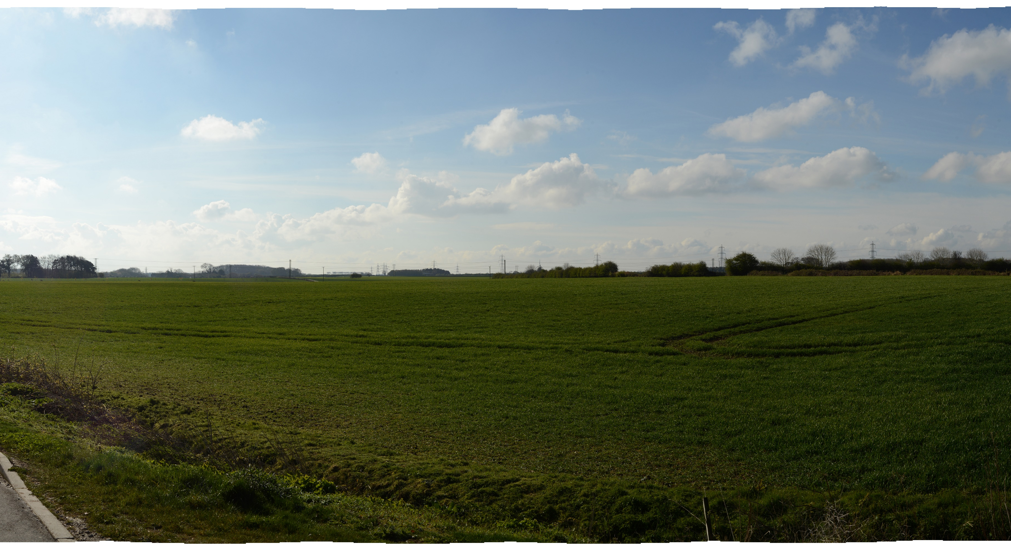
Viewpoint 8: Minster Way
Notes:
Viewpoint 8: Minster Way

Slide 21
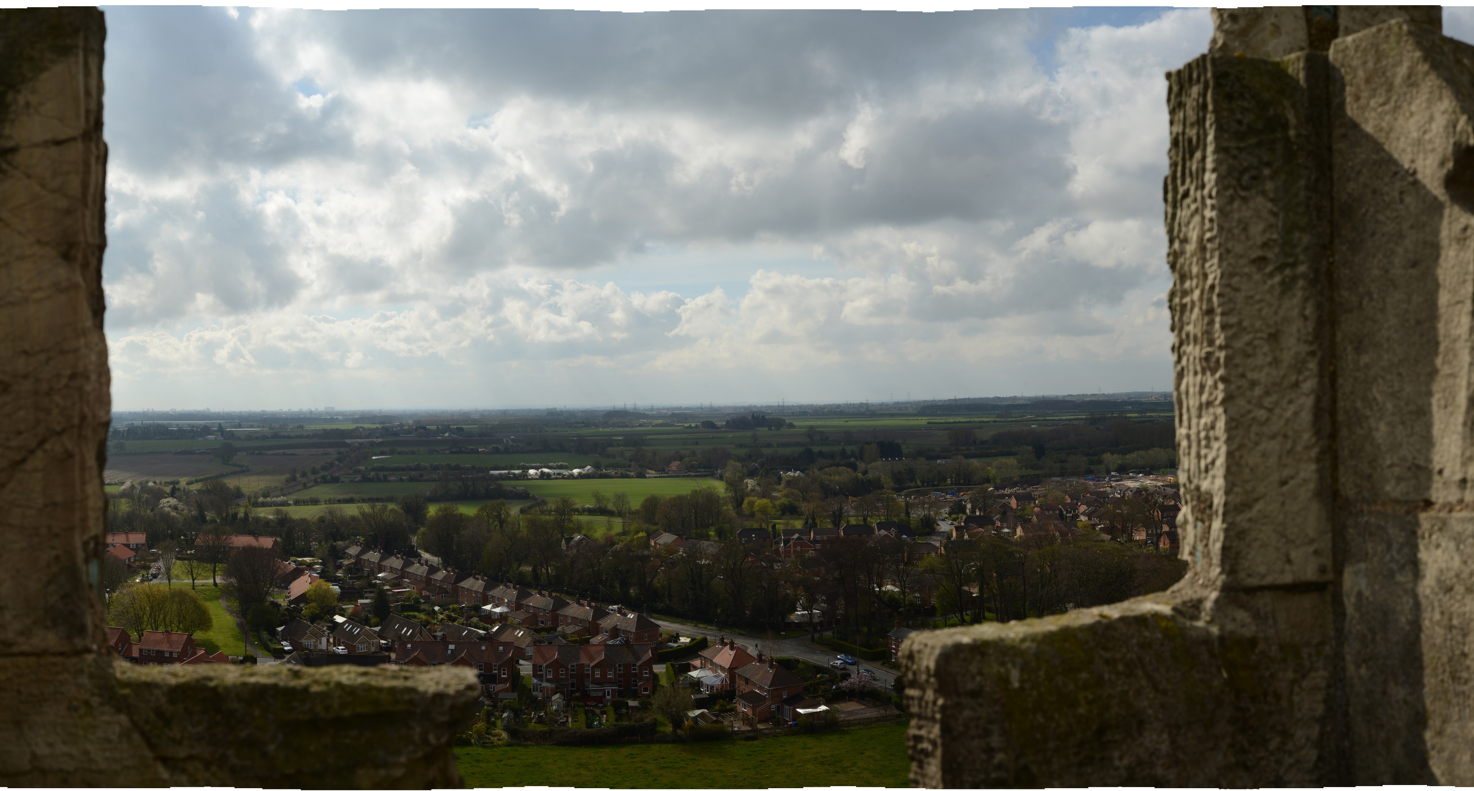
Viewpoint 9: Beverley Minster Tower
Notes:
Viewpoint 9: Beverley Minster Tower

Slide 22
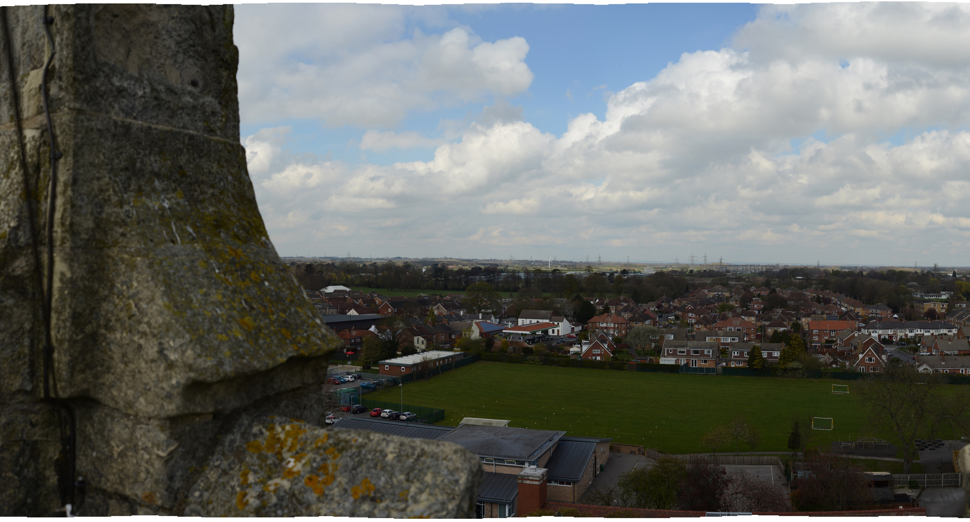
Viewpoint 10: St Marys Church Cottingham
Notes:
Viewpoint 10: St Marys Church Cottingham

